Slide 1

Indoor Plant Monitoring System Using IoT
by
A. Likhitha
Roll No. 204G1A0548
R. Lalitha
Roll No. 204G1A0547
K. Asha Nidhi
Roll No. 204G1A0516
K. Hema Latha
Roll No. 204G1A0539
Under the guidance of
Dr. B. HariChandana M.Tech.Ph.D
Associate Professor
Department of Computer Science and Engineering
Srinivasa Ramanujan Institute of Technology
(Autonomous)
2023 - 2024

Slide 2

Contents
Abstract
Problem statement
Objectives of Project
Literature survey for first objective
Literature survey for second objective
Proposed Work -(Methods to be followed for proposed system)
References
GitHub Link
Queries

Slide 3
Abstract
Nowadays, a lot of individuals are quite interested in doing their own gardening. Indoor gardening has a variety of advantages, including the ability to produce organic vegetables, use of the plants in home design, and air purification. People's busy schedules are the major obstacle to indoor gardening because plants require more attention for their growth and health, necessitating the hiring of a "plant sitter" if they leave on vacation. This problem can be solved by automating the plant monitoring using the "Internet of Things". Utilizing Raspberry pi and variety of environmental sensors, and camera module, to track the temperature, moisture, light and many other aspects and providing data on each of these elements via Blynk app.
Keywords: Indoor planting, Plant sitter, Raspberry pi, Camera

Slide 4
Problem Statement
Due to people's hurried lifestyles, indoor plants don't receive the attention they need, which has an effect on their growth and robustness.
To maintain the plant’s growth, a predetermined temperature, moisture, light and humidity levels as well as to spot bird activity, environmental factors must be continuously monitored and managed.

Slide 5
Objectives of Project
Research Objective-1: To prevent overheating through tracking the temperature and watering the plants using water pump automatically through assessing the soil's moisture content.
Research Objective-2: To secure the existence of plant through the utilization of a network of various sensors that safe guard against the consequences of bird activity.

Slide 6
Literature survey for first objective
This paper includes integrating the NodeMCU (ESP8266) microcontroller as the core component, serving as a unifying element for the entire module. This consolidation incorporates an array of sensors that are linked to the micro controller.[1] Also discusses, soil moisture sensor's purpose, which is primarily centred on identifying moisture present within the soil. Maintaining the right balance of moisture is essential to ensure proper nutrient absorption and prevent water stress. Soil moisture sensors are devices designed to measure the amount of water present in the soil. [2]

Slide 7
Literature survey for second objective
This paper describes about object detection. Using the application Real-Time Object Detection, one can discover in real time the boundaries of an object. A computer vision technology called object detection enables us to recognize and pinpoint certain things in an image. Using this form of localization and identification, object detection can be used to count the items in a scene, as well as to locate and track them in real time while precisely labelling them.[3]

Slide 8
Contd…
This research paper illuminates the utilization of the Blynk app within a plant monitoring system, showcasing its widespread adoption as a convenient approach for remotely overseeing and managing plant conditions. The discussion underscores the prevalent adoption of Blynk as a user-friendly and effective avenue for remotely managing and monitoring plant conditions. Blynk emerges as a prominent IoT platform, empowering users to craft personalized mobile applications tailored to their IoT ventures.[4]

Slide 9
Proposed System
To address the limitations of the existing system, we propose implementing a comprehensive solution, that employs a combination of various environmental sensors, which will constantly monitor variables such as solar exposure and temperature fluctuations, DC motors to provide shade for the plants when there is excessive heat and smart gadgets like camera module to track the presence of birds and make a buzzer sound.

Slide 10
References
[1]. Mubashir Ali, Nosheen Kanwal, Aamir Hussain, Fouzia Samiullah, Aqsa Iftikhar and Mehreen Qamar, “IoT based smart garden monitoring system using NodeMCU microcontroller” International journal research in Applied Science & Engineering Technology, pp. 117-120, May. 2020.
[2]. C. Vijaya Bhaskar, A. LakshmiPriya, K. HemaPriya, A. HemanthKumar and V T Kireeti, “Soil Moisture Detection and Monitoring through Iot” Journal of Electronics and Communication Engineering Research, vol. 8, pp. 10-13, April. 2022.
[3]. Dr M. Mahesh, Varun Reddy, Abhishek Reddy, Charan Reddy, “Object Detection and Dimensioning Using OpenCV” International Journal of Creative Research Thoughts, vol. 10, pp. 60-68, June. 2022.

Slide 11
Continued…
[4]. Priyanka S Talekar, Abhishek Kumar, Amit Kumar, Manish Kumar and Md. Irfan Hashmi, “Smart Irrigation Monitoring System Using Blynk App” International journal of Innovative Science and Research Technology, vol. 6, pp. 1353-1355, July.2021.

Slide 12
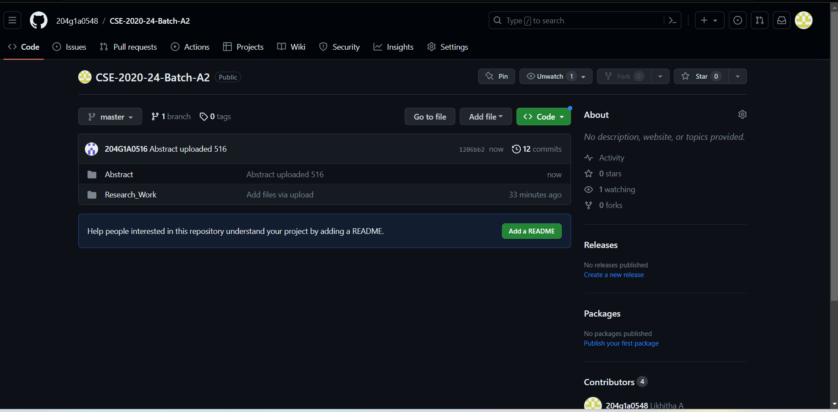
Git Hub Dashboards of each student
Git Hub Link: https://github.com/204g1a0548/CSE-2020-24-Batch-A2.git

Slide 13
Any Queries?

